Slide 1
JOB ANALYTICS FOR LINKEDIN JOBS
TEAM MEMBERS
SAMEER SINGH
VISHAL TOMAR
ASHISH RANA
SUCHITH HM
SAHIL JAMWAL

Slide 2
Introduction
This project is on 3 phases :-
Phase-I :- Scrape data from professional networking platform Linkedin, make 3 tables using the data & generate insights.
Phase-II :- Based on Employee count and LinkedIn followers, categorized the company in Class1, Class2 , Class3 and Class4 by clustering algorithm.
Phase-III :- Created a Web page where you can search for the job with the help of designation.

Slide 3
Steps involved in project
Web Scraping
Using Selenium and
Beautiful Soup
Data Cleaning using Python and Excel .
Presenting an Insights Using
Tableau
Study the problem statement.
Inspecting LinkedIn Website.
Doing clustering by ML.
And Finally make web page.

Slide 4
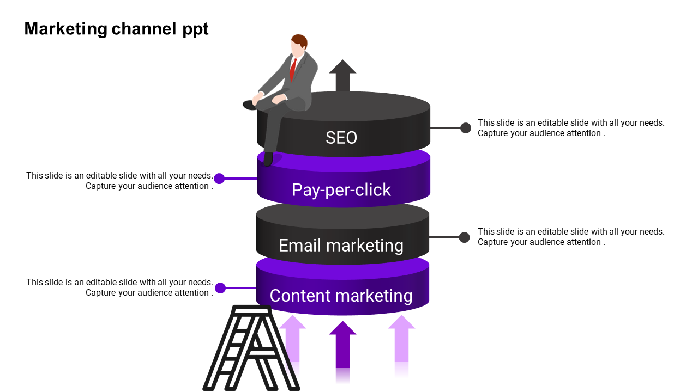
TOOLS USED
Connected data from “csv” to web-page
JAVA
For making web page
HTML,CSS
For Visualization & drawn insights
Tableau, SQL
Web Scraping
Using Selenium and
Beautiful Soup & Data Modelling
Python ,Excel

Slide 5
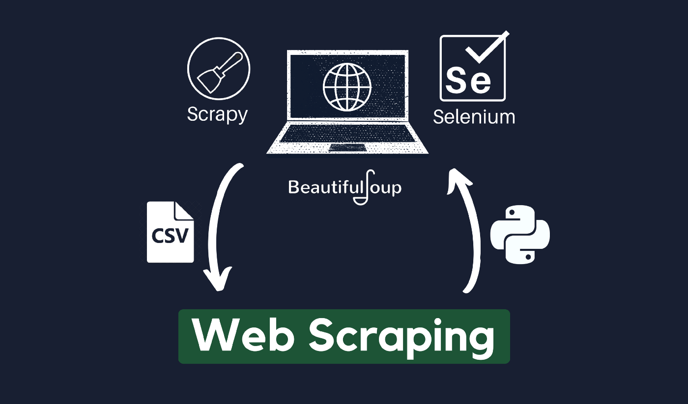
Slide Title

Slide 6

Insights
Insights
METROPOLITAN and comparatively more developed cites are leading in providing most jobs across INDIA.
MICROSOFT, IBM, THE GOLDEN RISE, AIR PRODUCTS INDIA and AMERICAN EXPRESS are the top 5 companies in terms of offering the number of jobs opportunities.
We found that the highest number of openings are for the entry level jobs.
Data suggest that IT SERVICES, SOFTWARE FIELDS, HEALTH CARE and AUTOMATION are the industries more popular among the applicants.
Most of the applicants are aiming for leading companies in their sectors and a trend of less applications are seen in not so popular firms..
People applying for the jobs at companies which have large number of followers.

Slide 7
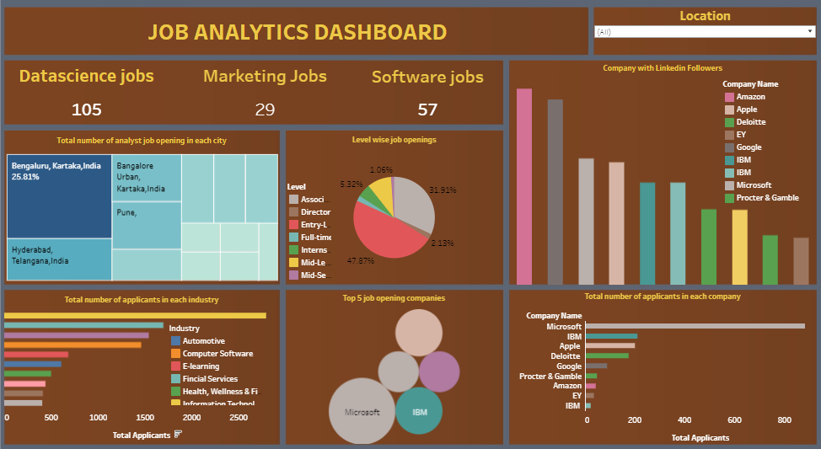
Job Analysis Dashboard

Slide 8
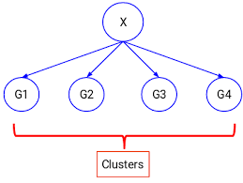
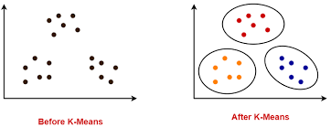
Data K-means Clustering
CCOMPANY TABLE
Based on Employee count and LinkedIn followers, we categorize the company Table in Class1, Class2 , Class3 and Class4
11
12
13
14
CCLASSES

Slide 9
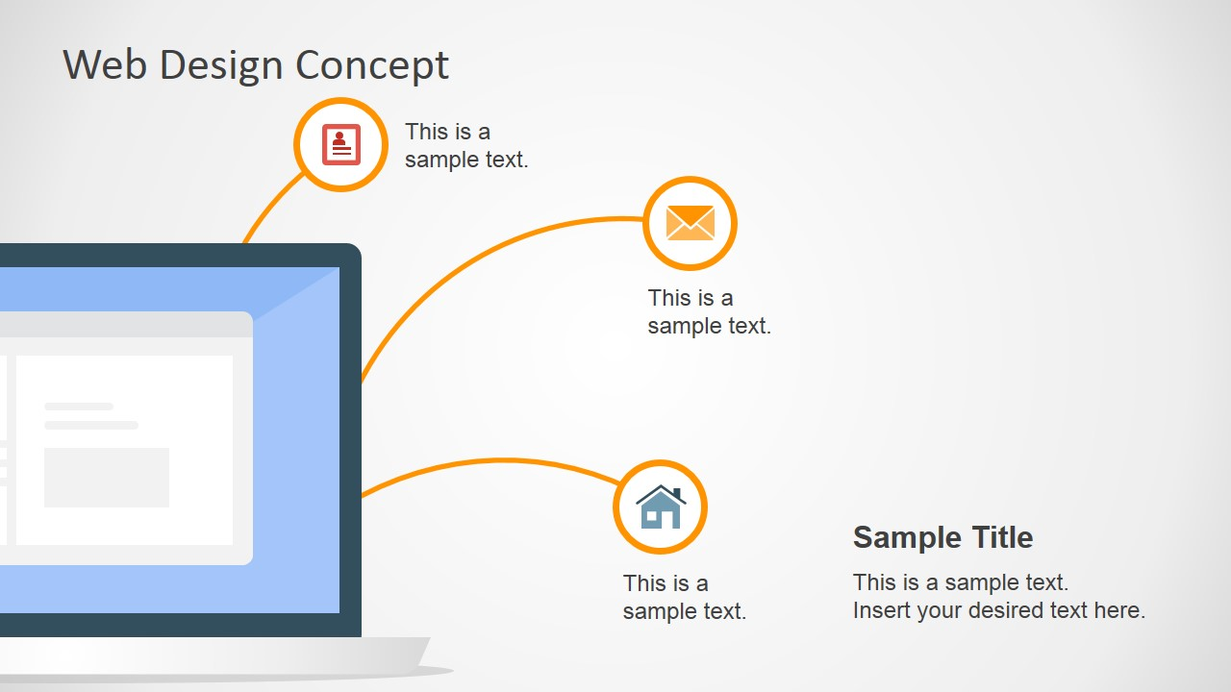
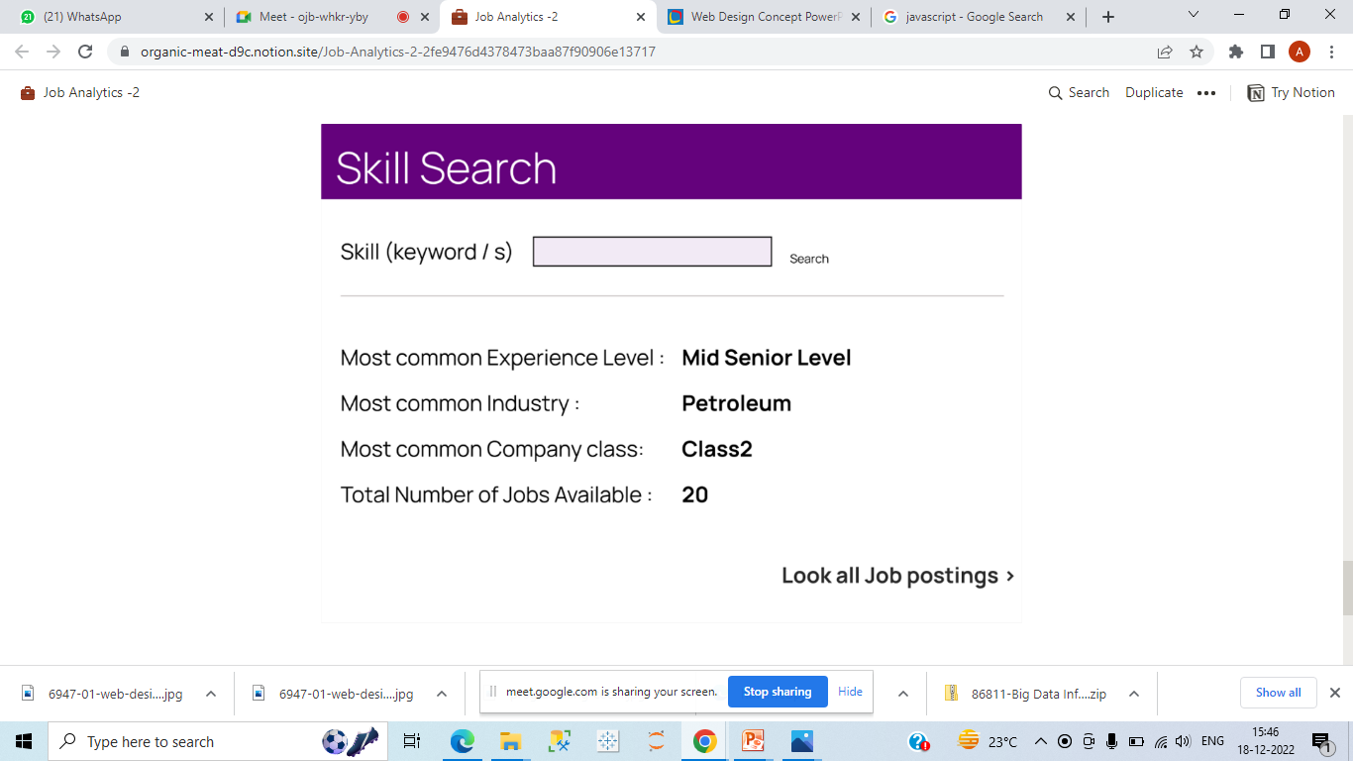
WEB PAGE
HTML:-standard markup language for documents designed to be displayed in a web browser.
CSS:-Cascading Style Sheets is a style sheet language used for describing the presentation of a document written in a markup language such as HTML/XML.
JAVA Script:- to create dynamic and interactive web content like applications and browsers
In this we created a web page where we can search for the jobs eg. User can search for Data Analytics, Web developer etc.

Slide 10
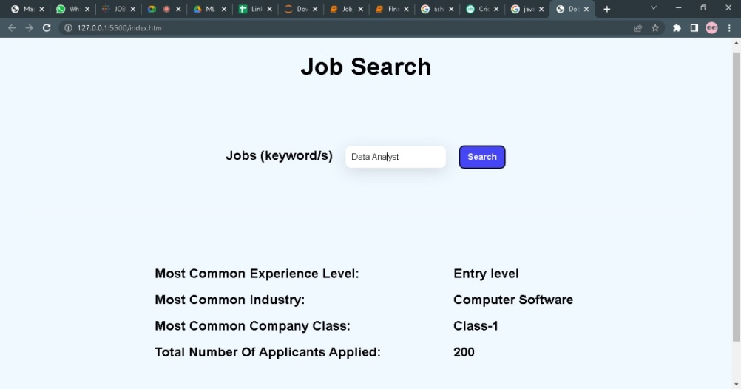
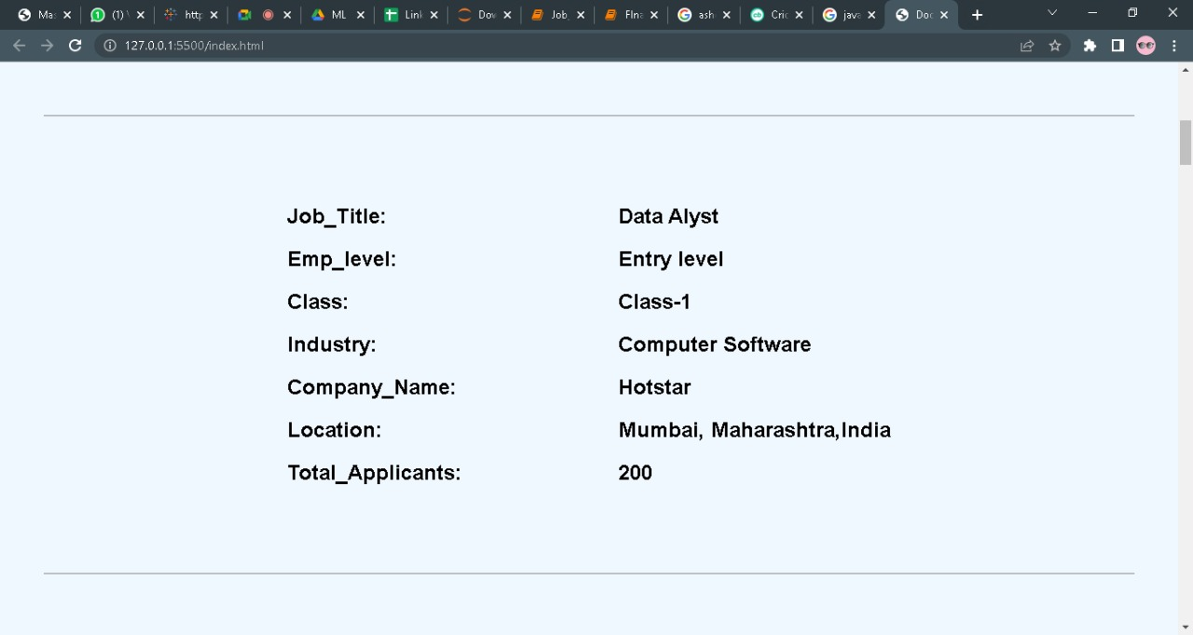
Web-Page
Following info user can get displayed once, a Jobs(keyword) is searched
Most common experience level (From Details table)
Most common industry where that skill or multiple skills are required
Most common Company Class where that skill is required
Number of Jobs available for the skill
An option is also provided so that, user can view all the job roles
Data Analyst

Slide 11
CHALLENGES FACED
Ph-1
Ph-2
Ph-3
DATA SCRAPING
In Data Modelling
Web page creation
Data Scraping is new for us. So, first learn Data scraping & then implement.
In phase-2, we face some problem in data modeling ,dividing table into classes
Html, CSS, JavaScript new for us. So, in this we faces challenges

Slide 12
Learning's:-
Major Learning's
WEB SCRAPING: Working knowledge on Python Packages like Selenium, BeautifulSoup Lib, how to do web scraping.
01
Explore more Tableau, how o use Tableau in projects.
02
How to make Data model ,web page & explore HTML, CSS ,Java scripts
03
Team work & how to deal with project deadline
.
04

Slide 13

This is the END of our Presentation.
And your turn to ask us anything related to the project

Slide 14


